Slide 1
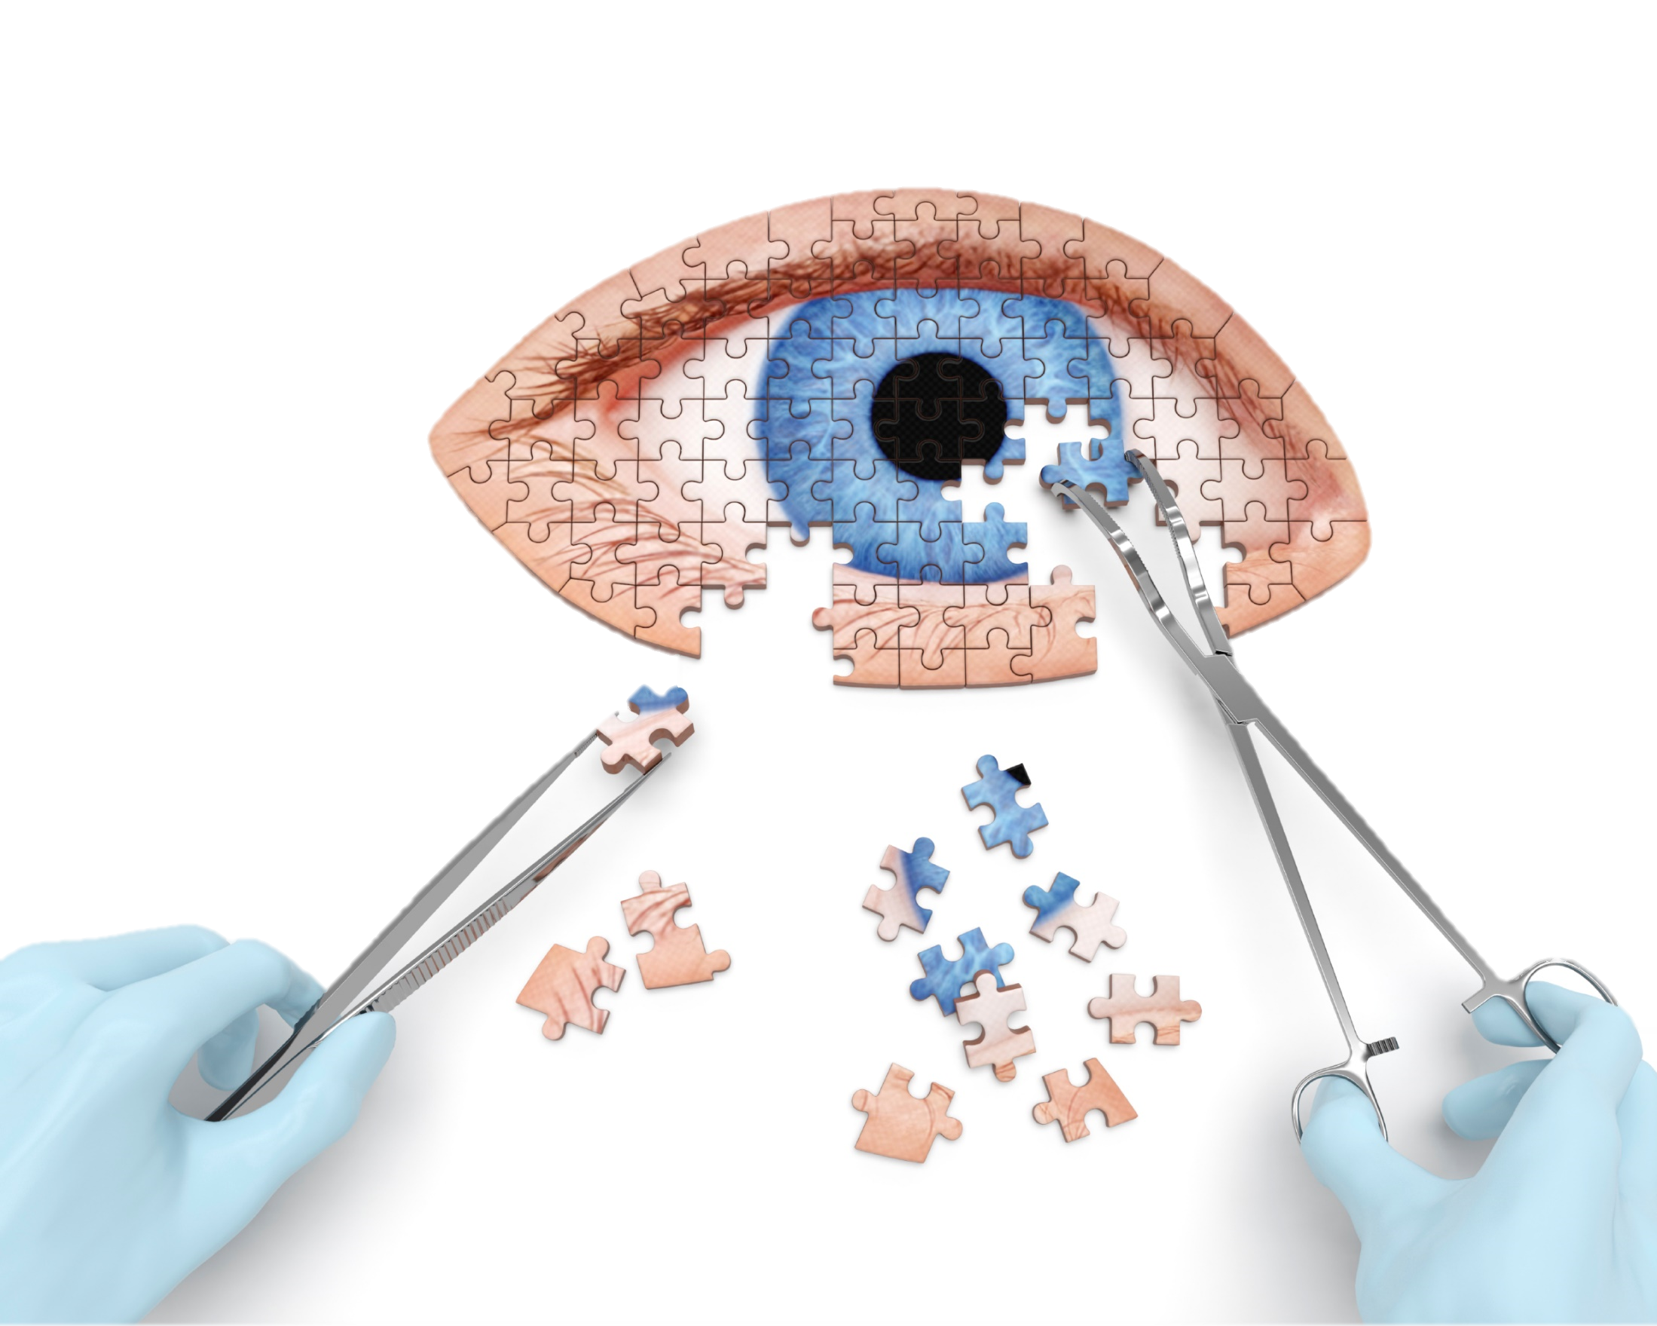
Canadian Association of Optometrists
Cataracts

Slide 2
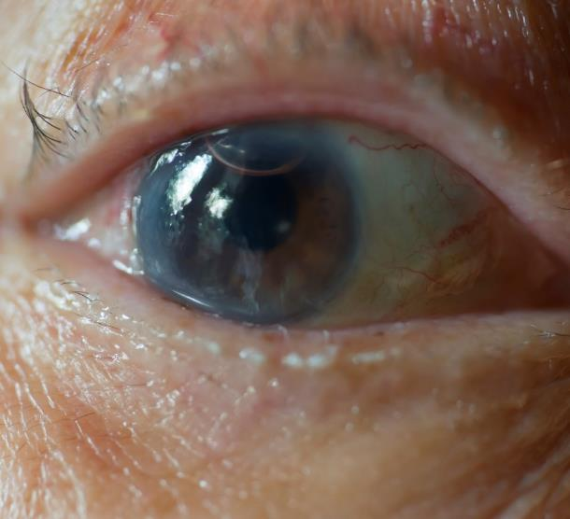
What are Cataracts?
More than 2.5 Million Canadians have cataracts
With age, the lens of the eye hardens and can become cloudy
Spots vary from small and cloudy to large and opaque
Can blur vision and interfere with performing normal visual tasks
Notes:
When the normally clear lens within your eye becomes cloudy and opaque, it is called a cataract.
Cataracts vary from extremely small areas of cloudiness to large opaque areas that cause a noticeable blurring of vision.

Slide 3
Who gets Cataracts?

Slide 4

Cataract risk factors
Cataracts most commonly occur with age (60+)
Family History
Sun exposure
Lifestyle choices
Other health problems
Certain medications
Eye injuries
Notes:
Cataracts are a function of aging and are most often found in people over the age of 60, although they are also occasionally found in younger people, including newborns.
If a child is born with a cataract, it is referred to as a congenital cataract.
Other health problems – complications such as diabetes
Medications
Eye injury (puncture, cut, intense heat or chemical burn to the eye)

Slide 5
What causes Cataracts?

Slide 6
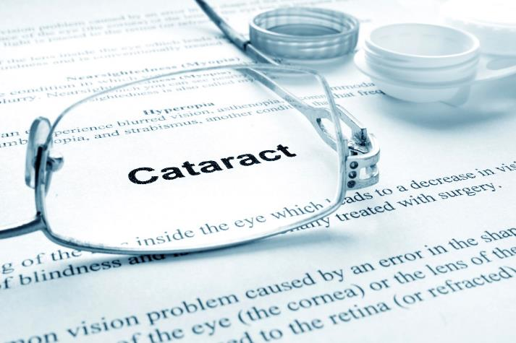
What causes Cataracts?
Changes to the eye’s lens that occur with age from various factors
Heredity, disease or injury
Cataracts usually develop in both eyes, but at different rates
Cataracts develop without pain or redness
Notes:
Cataracts are the result of aging changes that occur within your eyes that cause the lenses to become cloudy. This may be due to advancing age or it may be the result of heredity, an injury or a disease. Excessive exposure to ultraviolet radiation (present in sunlight), cigarette smoke, certain systemic conditions, or the use of certain medications are also risk factors for the development of cataracts. Cataracts usually develop in both eyes, but often at different rates.

Slide 7
What are signs/symptoms of Cataracts?

Slide 8

What are the signs/symptoms of Cataracts?
Blurring or hazy vision that glasses do not correct
Sensation of film on the eyes
Temporary changes in near/distance vision
Increased sensitivity to glare
Notes:
Some indications that a cataract may be forming include blurred or hazy vision that cannot be corrected by changing the glasses prescription, or the feeling of having a film over the eyes that does not go away with blinking. A temporary change in distance and/or near vision may also occur. An increased sensitivity to glare, especially at night may be experienced. Cataracts develop without pain or redness.

Slide 9
Are Cataracts preventable?

Slide 10

Are Cataracts preventable?
There is no proven way to prevent Cataracts from forming, but the process may be slowed down by:
  Wearing sunglasses with 100% UV protection
  Good lifestyle choices, and
  A healthy diet rich in antioxidants
Notes:
Currently, there is no proven method to prevent cataracts from forming.
UV rays can speed up cataract formation
A diet rich in antioxidants (such as Vitamins A, C, E, Zinc Selenium & Magnesium) can also be beneficial.

Slide 11
How are Cataracts treated?

Slide 12
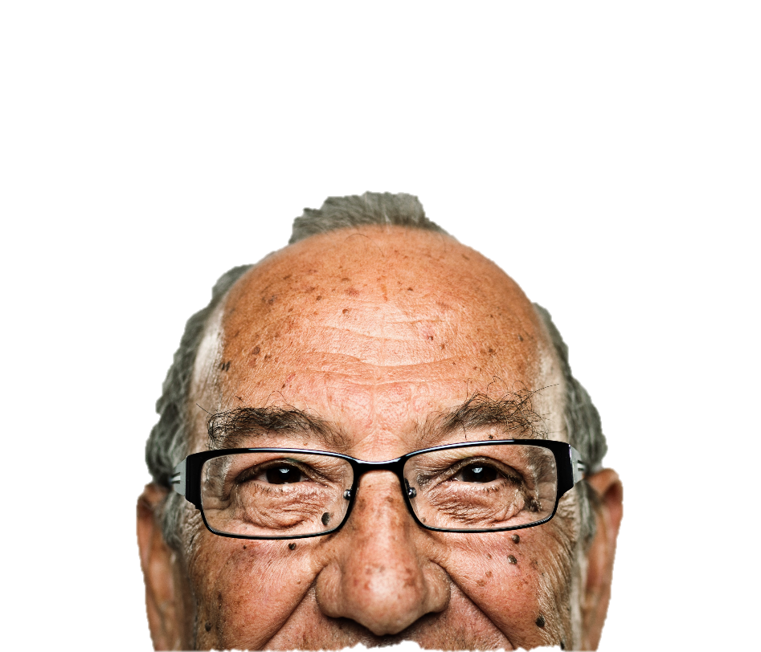
How are Cataracts treated?
In early stages, your doctor of optometry can prescribe new lenses or vision aids
When cataracts start to interfere with your daily activities
Notes:
In the early stages of a cataract, where vision is only minimally affected, your doctor of optometry can sometimes prescribe new lenses for your glasses to give you the sharpest vision possible.
When the cataracts start to interfere with your daily activities and glasses cannot improve this vision, your doctor of optometry will refer you to an ophthalmologist (eye surgeon) who may recommend the surgical removal of the cataracts.

Slide 13
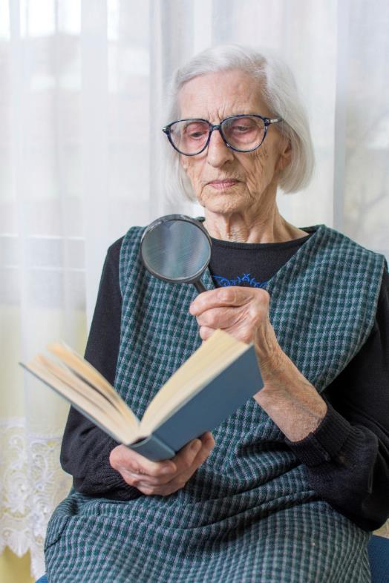
When will I need to have Cataracts removed?
Cataracts can develop quickly or over time
When glasses can no longer provide functional vision
Your doctor of optometry will arrange a consultation with a cataract surgeon
Notes:
Some cataracts never progress to the point that they need to be removed.
When a change in glasses can no longer provide functional vision, and the cataract is starting to interfere with your daily activities, your doctor of optometry will arrange a consultation with a cataract surgeon.
Before surgery, your doctor of optometry may recommend lens implant options with new “specialized” intraocular lenses designed to minimize your need for glasses following the surgery.

Slide 14
What can I expect after Cataract Surgery?

Slide 15

What happens after Cataract Surgery?
A lens implant is inserted during surgery to replace the old cloudy lens
Your doctor of optometry will assess your new vision needs four to six weeks after surgery
Notes:
Sometimes the lens implant can give you good enough distance vision that you may not require glasses.
Near vision will still be blurred, so you may need reading glasses
Your doctor of optometry will prescribe new lenses for your glasses about four to six weeks after surgery to maximize your distance and near vision.

Slide 16
Thank You.

