Slide 1
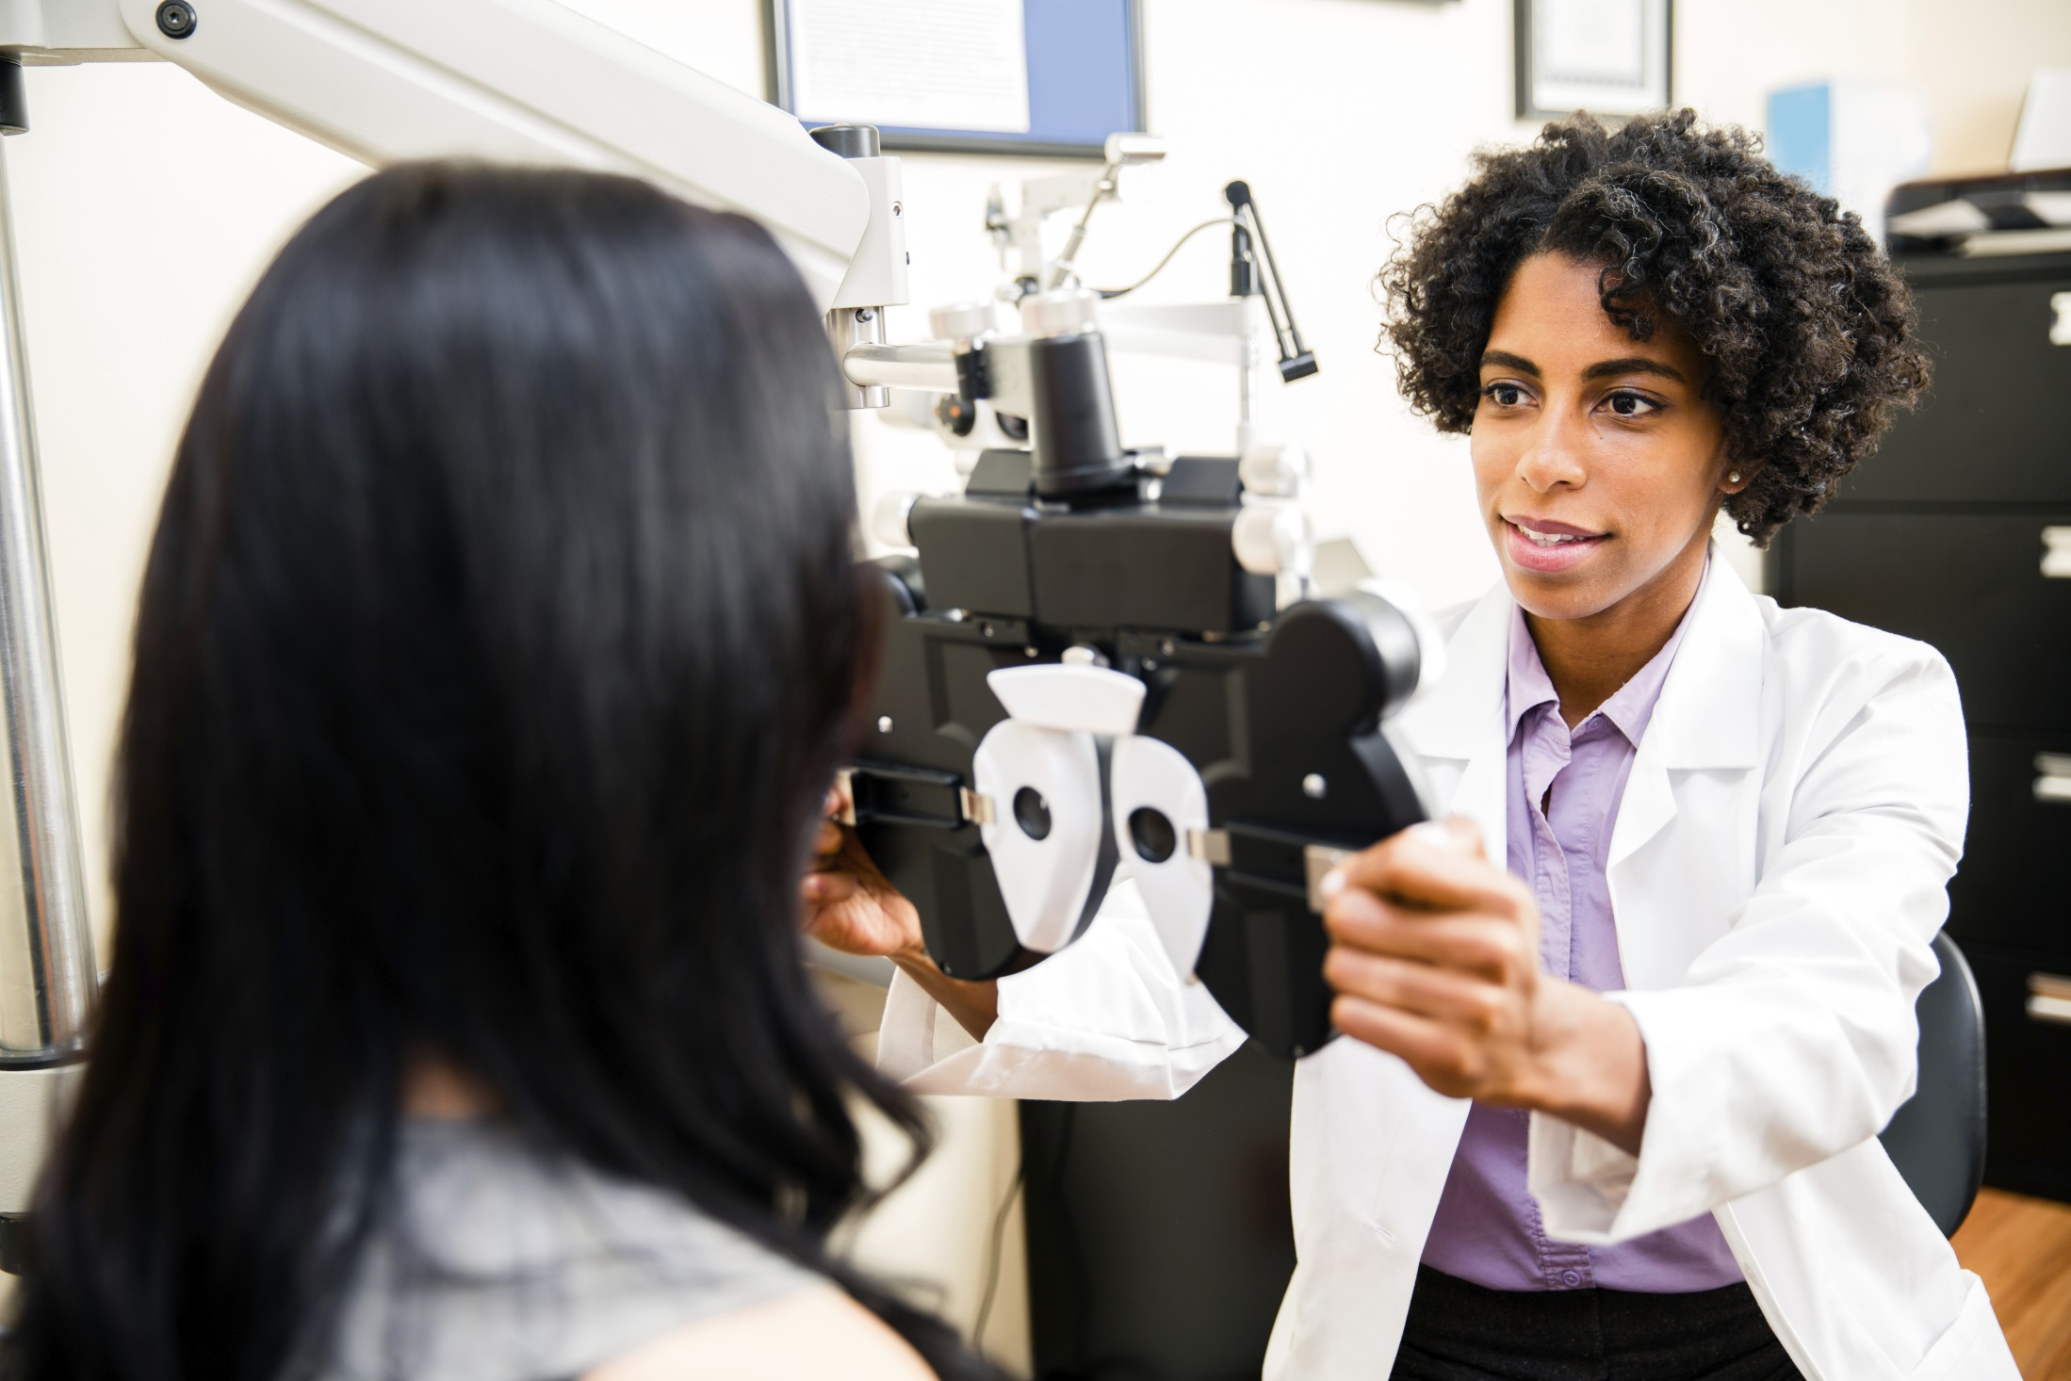
Canadian Association of Optometrists
Dry Eyes
Notes:
Off the glaucoma powerpoint

Slide 2

What is dry eye?
The tears your eyes normally produce are necessary for overall eye health and clear vision. Dry eye occurs when your eyes do not produce enough tears or produce tears that do not have the proper chemical composition.

Slide 3
What causes dry eye?

Slide 4
What causes dry eyes?
Dry eye symptoms can result from
  the normal aging process,
  hormonal changes,
  exposure to certain environmental conditions, problems with normal blinking
  from medications such as antihistamines, oral contraceptives or antidepressants
Dry eye can also be symptomatic of general health problems, such as arthritis, or can result from UV exposure and environmental irritants.

Slide 5
What are signs/symptoms of dry eye?
Notes:
From the glaucoma PPT

Slide 6

What are signs/symptoms of dry eye?
The common signs and symptoms of dry eye include:
  stinging,
  gritty,
  scratchy
  fluctuating vision
  sometimes having a burning feeling or a feeling of something foreign within the eye
  Some people experience tearing as a result of dry eye
This is a natural reflex of the eyes to create more tears to comfort the eye in response to dryness.

Slide 7
How is dry eye diagnosed?

Slide 8
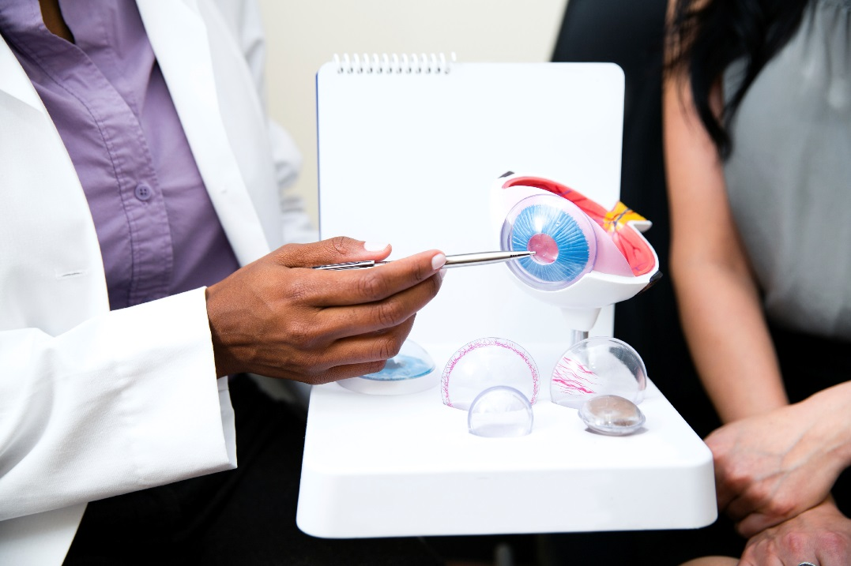
How is dry eye diagnosed?
Your OD will ask questions about your general health, your use of medications and your home/work environments to determine any factors which may be causing dry eye symptoms.
The use of a slit lamp, in conjunction with special dyes, will allow your OD to evaluate the quality, the amount and the distribution of tears to detect signs of dry eyes.

Slide 9
Can dry eye be cured?
Notes:
File #: 1461692Exclusive

Slide 10
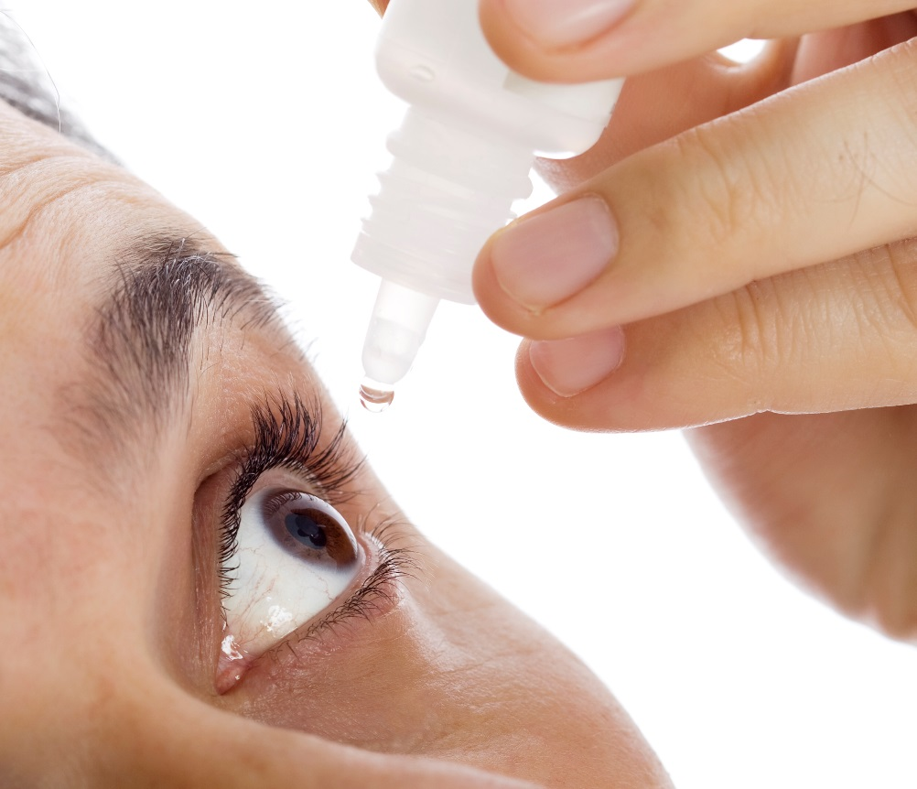
Can dry eye be cured?
Dry eye is usually chronic and cannot be cured, but your comfort can be improved and eye health maintained through use of artificial tears.
For more severe dry eye, gels and ointments can be used, especially at bedtime.

Slide 11
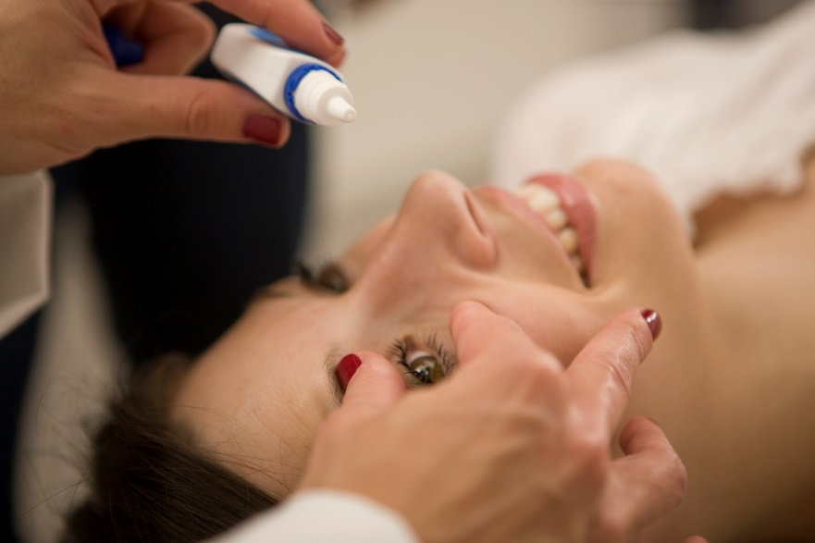
Can dry eye be cured?
Your OD is the best source to advise on the best drops for you.
Treating any underlying systemic disease, or a change of diet to include items such as fish or flax seed oil can also be helpful at times. New prescription medications are now available to help your body produce more of it’s own tears.

Slide 12
Will dry eye harm my eyes?

Slide 13
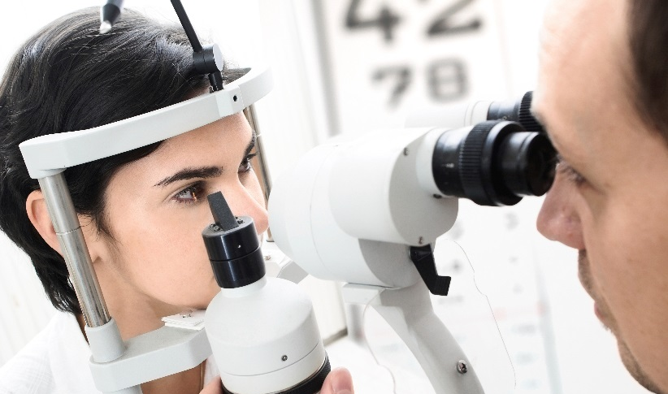
Will dry eye harm my eyes?
If dry eye is left untreated, it can be harmful.
Excessive dry eye can damage tissue and possibly scar the sensitive corneal tissues of your eye, impairing vision.
Dry eye can make contact lens wear more difficult due to increased irritation and greater chance of eye infection.
To keep dry eye symptoms in check, you and your Doctor of Optometry need to work together. Follow your OD’s instructions carefully.

