Slide 1
Canadian Association of Optometrists
Myopia
Notes:
Off the glaucoma powerpoint

Slide 2
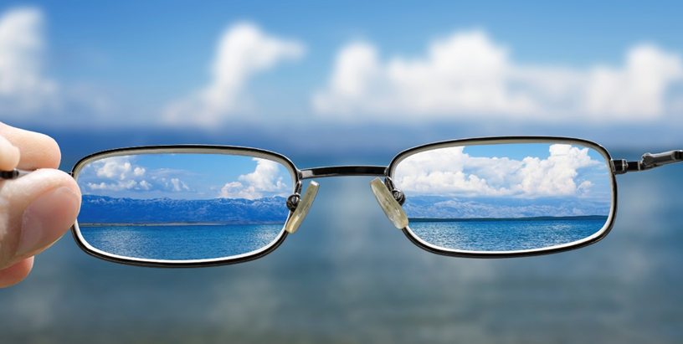
Myopia
Myopia, or Nearsightedness is a visual condition in which near objects are seen clearly, but distant objects do not come into proper focus.

Slide 3
Why does myopia occur?

Slide 4
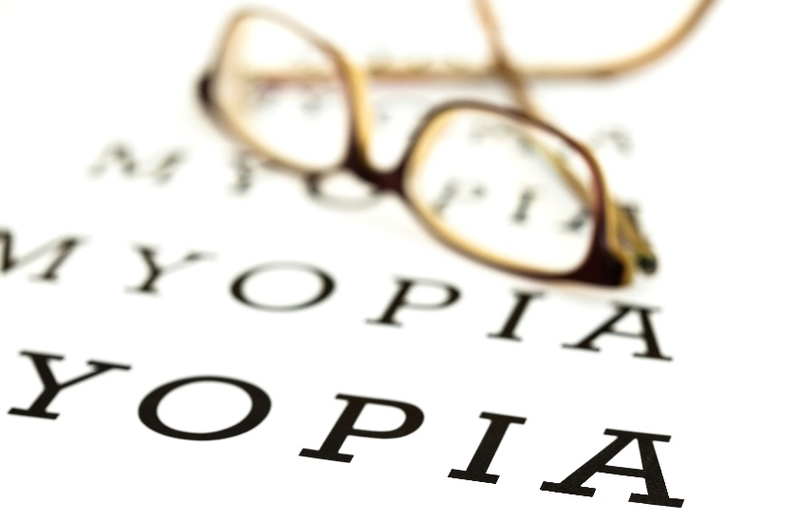
Why does myopia occur?
When your eyeball is too long or the cornea has too much curvature it will result in:
The light entering the eye will not focus properly on the retina, the sensory layer, inside the eye.
Myopia may be hereditary or it may occur spontaneously.

Slide 5
How common is myopia?
Notes:
From the glaucoma PPT

Slide 6
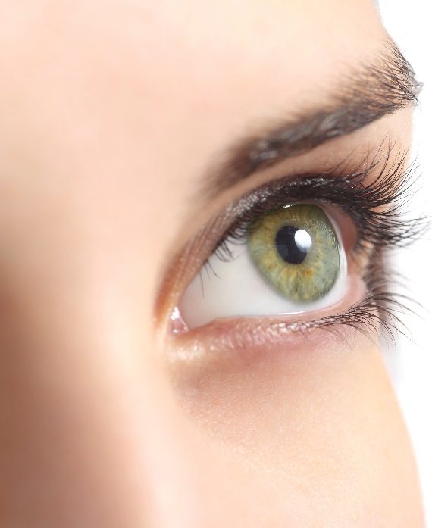
How common is myopia?
Myopia is a visual condition that affects nearly thirty per cent of the Canadian population.
It normally starts during childhood and continues to increase until the individual reaches the age of 20.

Slide 7
Will I have to wear glasses?

Slide 8
Will I have to wear glasses?
You may need glasses for distance only or full time as the prescription increases to enable you to see more clearly.
If needed, your OD will prescribe corrective lenses for you.
You may only need them for certain activities, like watching television, going to a movie or driving a car.

Slide 9
Will glasses or contact lenses cure myopia?
Notes:
File #: 1461692Exclusive

Slide 10
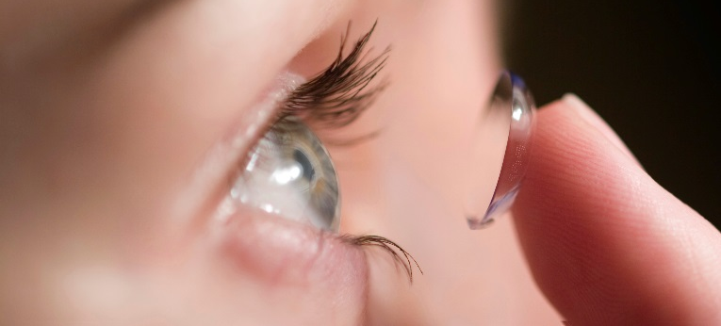
Will glasses or contact lenses cure myopia?
There are currently no proven cures for nearsightedness.
Eyeglasses or contact lenses optically correct the problem by altering the way the image enters your eyes.
Surgical procedures such as LASIK, PRK or SBK, and/or lens implants may eliminate your need for glasses or contact lenses.

Slide 11
How is myopia diagnosed?

Slide 12
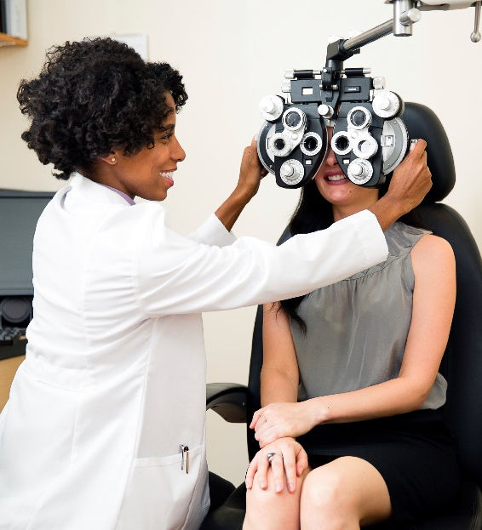
How is myopia diagnosed?
People with myopia will often have trouble seeing the whiteboard, the movie screen, the television set or other distant objects.
When your optometrists gives you a comprehensive eye examination, he or she will include tests to determine if there is a prescription for myopia.

Slide 13
How will myopia affect my lifestyle?
Notes:
From the glaucoma PPT

Slide 14
How will myopia affect my lifestyle?
If glasses or contact lenses are prescribed, it may take up to two weeks to adjust to seeing clearly with them.
Some people with myopia may find that they are restricted from some occupations such as:
police officers or fire fighters - due to their inability to see properly if their glasses fall off.
In these cases, contact lenses or laser surgery are options for correcting nearsightedness and are ideal for people with more active lifestyles.

Slide 15
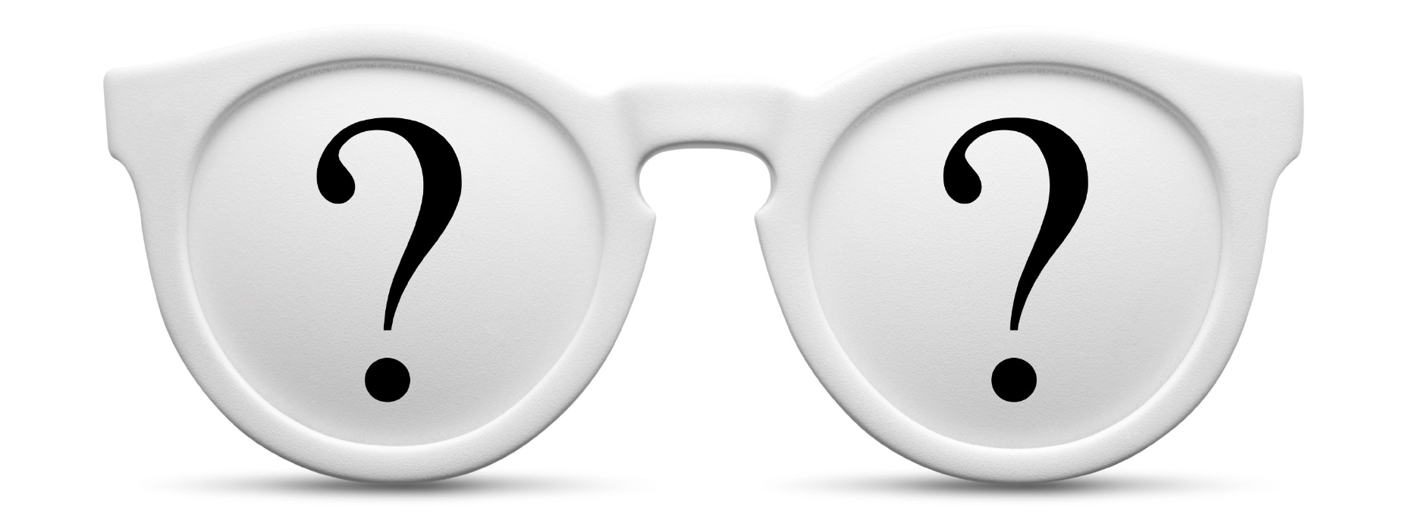
Thank You. Questions?

