Slide 1


Thinking about a Future
Career in Canada?

Slide 2

Practicing in Canada
Write the Optometry Examining Board of Canada qualifying exam*
Pick the province you wish to practice in
Register with the provincial College
Join your provincial association
Check CAO’s jobs board (opto.ca)

Slide 3
Population/OD by Province
Province | Population | Practicing ODs | Population/OD
NL* | 519,716 | 61 | 8,520
PE* | 142,907 | 21 | 6,806
NS | 923,598 | 132 | 6,997
NB | 747,101 | 124 | 6,025
QC | 8,164,361 | 1549 | 5,271
ON | 13,448,494 | 2347 | 5,730
MB* | 1,278,365 | 165 | 7,478
SK | 1,098,352 | 183 | 6,002
AB | 4,067,175 | 766 | 5,310
BC | 4,648,055 | 745 | 6,239
* A hardcopy of this chart is available
Notes:
There are five times as many ODs as there are ophthalmologists in Canada.
2016 CAO membership survey showed that nearly 1/3 of ODs are located in cities with a population greater than 500,000.
More than 20% work in communities with populations of less than 25,000.

Slide 4
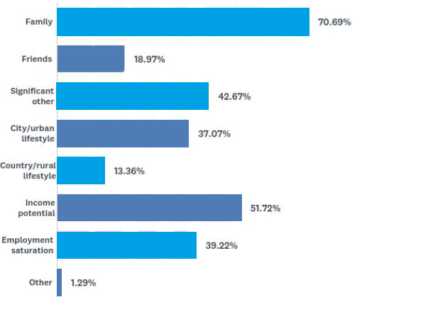
Influences on location of new grad practice
* A hardcopy of this chart is available

Slide 5

Scope of Practice
Can prescribe TPA in all Provinces
Orals available in Alberta, Saskatchewan and Ontario
ODs in Alberta and Manitoba can order lab tests
Need to ensure with Government that appropriate scope maximizes opportunity to ensure the right provider at the right time

Slide 6
Provincial Scope of Treatment
AUTHORITY TO TREAT
Province | Allergies | Infection | Inflammation | Glaucoma | Pain
NL | T | T | T | - | -
PEI | T | T | T | - | -
NS | T | T | T | - | -
NB | T | T | T | O (CA) | -
QC | T | T | T | T (co-man) | -
ON | T | T/O | T | T O (CA) | O
MB | T/O | T/O (Lab) | T | T (co-man) O (CA) | -
SK | T | T | T | T (co-man) | -
AB | T | T | T | T | -
BC | T | T | T | T | -
* A hardcopy of this chart is available

Slide 7
Provincial Eye Exam Coverage
Province | Children | Adults (generally 18-64) | Seniors | Diabetes
BC | Under 19 | If ocular disease, systemic disease or medication associated with risk to ocular health | 65+ | y
AB | Under 19 | If medically necessary, or diabetes or by MD requisition | 65+ | y
SK | Under 18 | If urgent or emergent condition, diabetes | If urgent or emergent condition, diabetes | y
MB | Under 19 | If medically necessary | 65+ | y
ON | Under 20 | If specified eye disease or disorder or MD requisition | 65+ | y
QC | Under 18 | If ocular emergency | 65+ | y
NB | One-time eye exam and glasses coverage at 4 | None | None | n
NS | Under 10 – once every 2 years | If health condition/medication presents a risk to ocular health, infection, allergies, inflammation, foreign body | 65+ once every 2 years | y
PE | Once during Kindergarten year & for red/dry eye | If red-eye, dry eye, diabetes | If red-eye, dry eye, diabetes | y
NL | None | None | None | n
* A hardcopy of this chart is available

Slide 8

Self Regulation: A privilege
Each province has its own Optometry Act to govern the practice of optometry
ODs in each province elect colleagues to form the College, responsible for administering the Act.
Primary role of the College: Protect the public.

Slide 9

CAO Strategic Plan
The CAO is dedicated to collaboratively advancing the highest standard of primary eye care through the promotion of optimal vision health.
We strive to create awareness and be the go-to resource for:
Members
Decision makers
Stakeholders
Public

Slide 10

CAO’s 5 Strategic Goals
Create high awareness of the full benefits of optometric care.
Serve as the go-to resource for government decision-makers, the public, media, and other health care professionals on primary eye care/ vision care in Canada and the profession.
Protect and expand economically successful practices based on member priorities.
Serve as the go-to resource for optometrists for news, trends, products and new developments in optometry.
Increase accessibility and utilization of comprehensive eye care in underserved populations.

Slide 11

National Political Action
Advocating for optimal eye health and vision care
Active engagement with Parliamentarians in both the House of Commons and the Senate as well as political and bureaucratic staff.

Slide 12

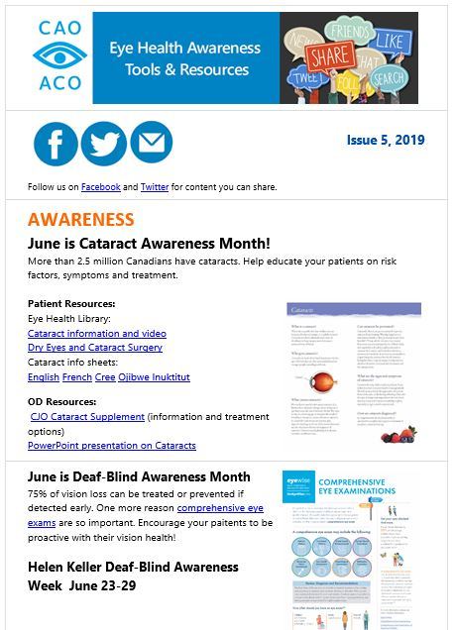

Communications – News and trends
Canadian Journal of Optometry
Quarterly publication with insightful articles, research, case studies and practice management tips.
Contact
Monthly eNewsletter with current news and issues affecting optometry.
CAO eBlasts
Notifications of relevant and urgent matters for practicing optometrists.
Notes:
.

Slide 13




Public Education
Get Eyewise is a digital awareness campaign to inform the public about preventable vision loss and eye health.
It includes a #SpecsAppeal contest with Maui Jim.

Slide 14


Slide 15
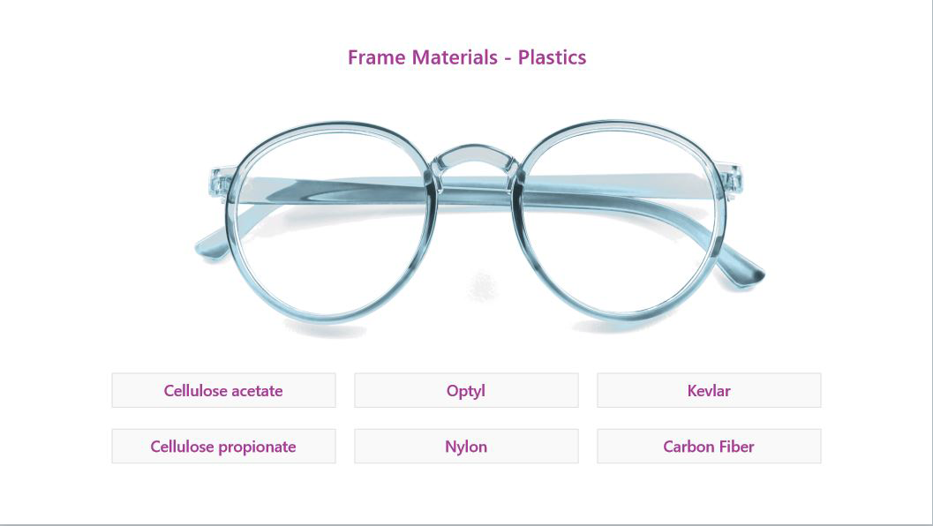

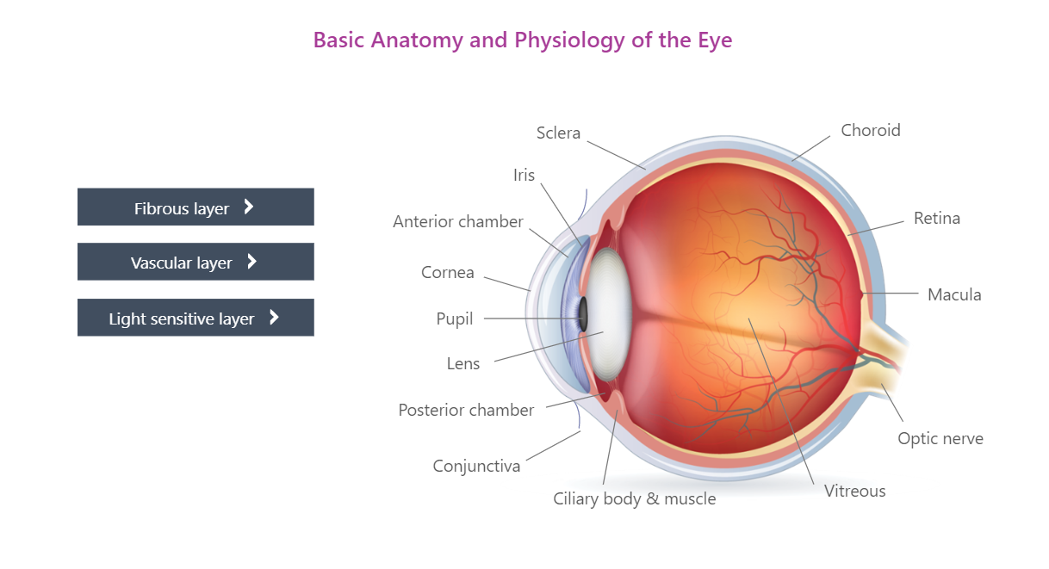
Continuing Education
Members have access to our exclusive continuing education opportunities.

Slide 16

Professional Liability Insurance
Regulatory Legal Expense Coverage
Criminal Defence Coverage
Sexual Abuse Therapy Fund
Cyber Security and Privacy Liability
Business Professional Liability
Pro Bono Legal Advice
NB: New grads qualify for discounts!

Slide 17
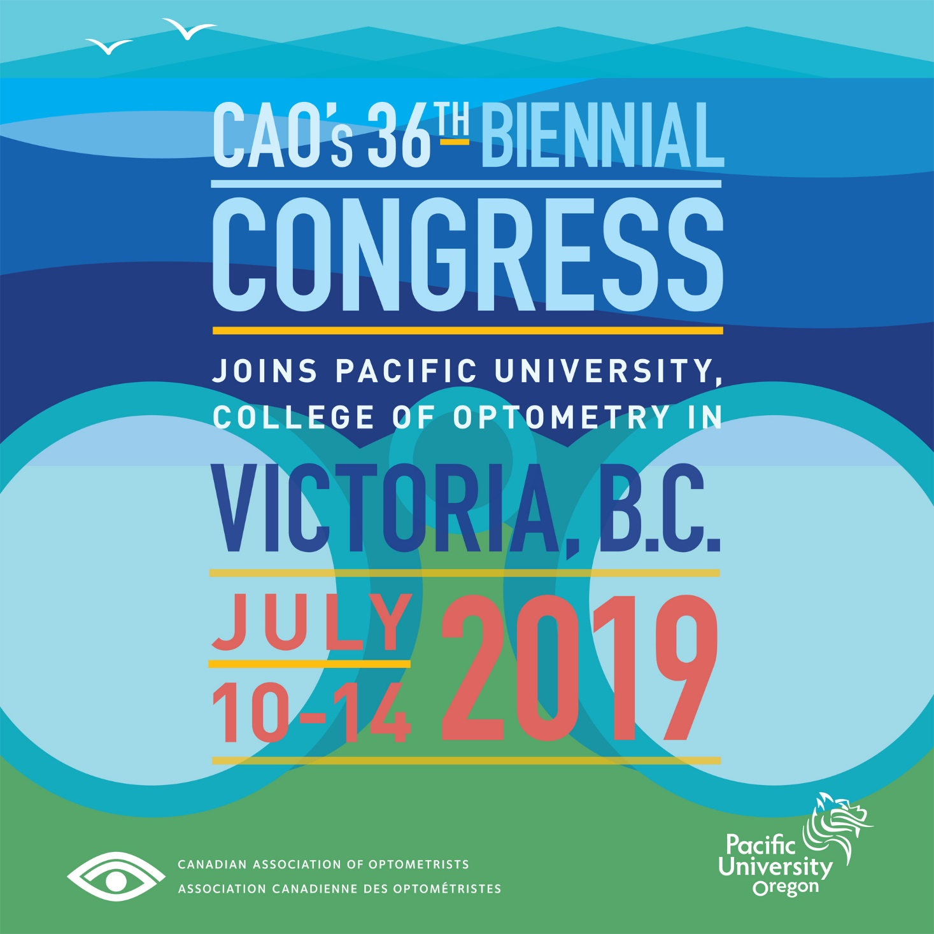

Slide 18
Thank You!
Opto.ca
Notes:
Thank You | end

