Slide 2
Félicitations
Gefeliciteerd
Congratulations
¡Felicidades
chúc mừng
बधाई हो
祝賀您
Glückwünsche
Συγχαρητήρια
Gratulerer
Поздравляю
Selamat
pagbati

Slide 3
Presentation Outline
Role of Regulatory College
Role of Professional Association
Cross Canada Checkup
Contact Information

Slide 4
Self Regulation – A Privilege
The right to be governed by your peers is a privilege granted to a few professions with a very sophisticated knowledge base
Each province has its own Optometry Act and Regulations to govern the practice of optometrists - optometrists in each province elect respected colleagues to a “College”, the body responsible for ensuring that all members comply with the Act and Regulations
Primary role of the College is to PROTECT THE PUBLIC!

Slide 5
Regulatory Colleges
Made of fellow optometrists and a few public members
Determine what academic credentials and clinical skills are required to enter the profession in the province
Establish and uphold standards of care and continuing education requirements
Investigate complaints from the public and discipline optometrists when necessary

Slide 6
An analogy
Optometry schools must ensure that the optometrists they graduate POSSESS the necessary skills and training to provide good optometric care. They grant an academic degree
Regulatory Colleges must ensure that the optometrists practicing in their province POSSESS & EXERCISE the necessary skills to provide good optometric care. The grant a license (the right) to provide optometry services to the public.

Slide 7
The Small Province Challenge
Provinces with 20-120 members have difficulty in developing a valid and defensible entrance examination.
All provinces have cooperated to develop a valid, sophisticated examination - the Canadian Assessment of Competence in Optometry (CACO) to verify the academic and clinical skills required for safe and effective practice of optometry
CACO is the only examination recognized by all provincial Regulatory bodies.

Slide 8
I’m Licensed. Where Do I Work?
Existing Optometry Practice: Income usually a percentage of revenue generated, sometimes with a guaranteed minimum.
Start a New Practice: Income based on profitability – revenue generated less all expenses. Significant investment required.
“Side by Side” with Retailer: Income usually based on percentage of professional fees. Usually no income generated from optical dispensing.

Slide 9
Competitive Business Challenges
Refracting Opticians (BC) – Remote refractions (Eyelogic)
Refracting Physicians
Ophthalmologists
Chain Store, Box Store and Grocery Store Opticals
Internet Retailers
Other Optometrists

Slide 10
Canadian Population Pyramid

Slide 11
Canadian Population is Aging

Slide 12
Challenge of Deregulation
In 2010 the BC government, against the advice of optometrists, ophthalmologists and opticians, unilaterally changed the eye care legislation in that province
Opticians can perform sight tests and order glasses
Patients no longer require a valid prescription to order glasses or contact lenses – anyone can legally dispense them.
BC optometrists are obliged to provide a PD with their Rx

Slide 13
Consequences of Deregulation
Asymptomatic eye disease remains undetected and visual outcomes suffer
No longer any enforceable standards to regulate the dispensing of eyewear
Dispensing services become devalued for optometrists as well as opticians
Corporate optical retailers no longer need ODs to generate Rx

Slide 14
Potential Challenges Ahead
Will deregulation spread across the country?
Will Competition Bureau push to lower standards of entry into the profession so more people can become optometrists?
Will economic pressures force employers to cut back on vision care plans for their employees?
Will Preferred Provider Organizations & Insurance companies steer more patients to non-optometry dispensaries?

Slide 15
The Challenge of “Adolescence”
Optometry as you have studied and will be prepared to practice did not exist prior to the time you were born
First Canadian TPA legislation in Alberta in 1997. How old were you?
Your scope of practice has been carved out, much of it recently, by optometrists not much older than you
We are not “entrenched” and untouchable. Ergo BC 2010

Slide 16
The Challenge of Optometry’s Future
Optometry’s future is entirely optometry’s responsibility. No other group is going to put our interests ahead of their own
Optometry’s future will be determined by the level of passion and commitment is members show toward shaping their own destiny
The privileges of being an optometrist and the scope of practice we exercise are up to us to win – or lose.

Slide 17
The Need for Collaboration
As individual optometrists, our voices will never be heard over the competition from the big players in the marketplace.
Optometrists need to speak with one voice in order to be heard above the noise of everyone else competing in the eye care industry
JOIN YOUR PROFESSIONAL ASSOCIATION

Slide 18
Invest in Yourself
You have already invested in your future by spending considerable time, money and energy into becoming educated as an optometrist
Once graduated, you need to keep investing in your future by spending some of your time, money and energy to ensure that the optometry profession you have joined stays strong and allows you to utilize all the skills you have acquired, and earn a good living in the process.

Slide 19
Provincial Associations- On Your Side!
Negotiate fair fees for services you provide
Defend existing scope of practice and advocate for expansion so you can use your acquired clinical skills
Provide Continuing Education opportunities to help you meet the CE requirements set by your College
Provide access to the most comprehensive and affordable malpractice insurance

Slide 20
Provincial Associations – On Your Side!
Provide mentorship services to help you navigate your way to success
Provide public education and advertising for optometry at a provincial level
Serve as the gateway to all the benefits you will receive as member of the Canadian Association of Optometrists

Slide 21
CAO Strategic Plan 2013-2018
To be the voice for doctors of optometry on federal vision care issues
To support doctors of optometry nationwide in practicing successfully by working in conjunction with provincial associations
To provide guidance for the future by managing the changes affecting the profession in a proactive manner
To provide support for students as they prepare to enter the workforce
To manage an effective and efficient organization that enables high performance

Slide 22
CAO Membership Benefits
As members, you have the mutual support of other optometrists who, like you, want to practice optometry in an environment where the value of our work is recognized and fairly rewarded.
You are served by a staff of full time professionals who go to work every day for the sole purpose of making things better for You, the optometrist.

Slide 23
CAO: Leadership Interaction
CAO facilitates the ongoing exchange of information and ideas among the provincial associations in their local battles to protect and develop the profession of optometry
OLF – annual symposium of provincial colleges and associations, optometry schools and national committees
CAO Biennial Congress – national meeting open to all ODs and optometry students (coming next to Fredericton 2015)

Slide 24
CAO: Membership Communication
Canadian Journal of Optometry is published quarterly
“In Touch” is a monthly eNewsletter that keeps members up to date about current news and issues affecting optometry
eBlasts are sent out as needed if there are issues of an urgent nature that are relevant to practicing optometrists.

Slide 25
CAO: Preferred Rates on…
Malpractice, health and life insurance
Car rentals and hotels
Merchant credit card services
Private labeled frame and lens programs
Waiting room patient/news services
Telephone “on hold” and practice newsletter services

Slide 26
CAO: National Political Action
CAO monitors the House of Commons and the Federal Ministry of Health and advocates for YOU whenever legislation or government policy has the potential to benefit or harm your ability to practice optometry in a rewarding manner
CAO has a government relations person on staff
CAO initiated and successfully advocated for passage of Bill C-313 which now regulates non-Rx contact lenses

Slide 27
CAO: Education for ODs and Staff
CAO hosts an extensive Optometric Continuing Education Program in conjunction with its Biennial Congress
Administers a national distance education program with a “hands on” component to train certified optometric assistants. Graduates may use the designation CCOA (Certified Canadian Optometric Assistant) after their names.

Slide 28
CAO: National Public Education
NPEC, a committee of CAO, administers a national public education campaign designed to raise public awareness about the value of receiving regular eye care from an optometrist, throughout life
Message is delivered via a variety of social media vehicles, radio, television and print
Portion of the campaign resources are reserved for use by provincial associations to address local needs and markets

Slide 29
DOC Campaign

Slide 30
CAO: Buying & Selling, Getting Hired
Inside the “Members Only” section of the CAO web-site you will classified ads for potential job opportunities
CAO web-site provides unbiased advice from experts on how you should evaluate a practice before you decide to “buy in”.

Slide 31
CAO: Public Education Resources
Variety of “in office” patient information pamphlets
Free “print ready” ad mattes and public service announcements that you can personalize and use locally to help build your practice
Free Powerpoint presentations on a number of topics that you can download and use when you make a presentation in your local area

Slide 32
CAO Biennial Congress
Largest gathering of optometrists in Canada
Top notch continuing education and large trade show
Great social events – opportunities for class reunions
Event is mostly sponsored by industry partners. Attending optometrists only pay a fraction of true cost of the event
Only open to CAO members and “free” for optometry students

Slide 33
Take Control of Your Future
Volunteer some of your time either in your provincial association or regulatory body (College)
Attend your annual provincial association meetings to learn from your peers and to share your ideas, concerns and insights
Do whatever it takes to shape your own future, or others from outside the profession will shape it for you.

Slide 34
Cross Canada Checkup

Slide 35
Population/OD by Province
Province | Population | Practicing ODs | Population/OD
NL* | 527,464 | 55 | 9,590
PE* | 145,295 | 20 | 7,265
NS | 940,567 | 118 | 7,971
NB | 755,710 | 121 | 6,245
QC | 8,174,510 | 1,449 | 5,641
ON | 13,585,887 | 2,049 | 6,630
MB* | 1,268,915 | 145 | 8,751
SK | 1,114,170 | 156 | 7,142
AB | 4,060,719 | 645 | 6,295
BC | 4,603,375 | 637 | 7,231

Slide 36
Provincial Scope of Treatment
 | AUTHORITY TO TREAT
 | Allergies | Infection | Inflamm’n | Glaucoma | Pain
NL | T | T | T | - | -
PEI | T | T | T | - | -
NS | T | T | T | - | -
NB | T | T | T | O (CA) | -
QC | T | T | T | T (co-man) | -
ON | T | T/O | T | T O (CA) | O
MB | T/O | T/O (Lab) | T | T (co-man) O (CA) | -
SK | T | T | T | T (co-man) * | *
AB | T | T | T | T (co-man) | -
BC | T | T | T | T (co-man) | -

Slide 37
Newfoundland and Labrador

Slide 38
NL: Coverage
No services provided by optometrists receive provincial funding

Slide 39
NL: Local Comments
“The lifestyle benefits are without parallel across Canada … Newfoundland possesses a rich cultural heritage and is known for its vibrant arts and entertainment industry….we have an abundance of outdoors adventure activities and past times from hunting and fishing to whale watching, hiking, and ice berg viewing.”

Slide 40
Prince Edward Island

Slide 41
PEI: Coverage
Optometric services have never been insured. Currently working with government to gain coverage for patients with diabetes, red eyes and dry eyes.

Slide 42
PEI: Local Comments
“Large population over age 40 - great community atmosphere in province, housing costs are reasonable”
“We have a relatively high ratio of optometrists to population. Some people find adapting to life on the island difficult.”
"There are really no prospects for new graduates in PEI at the present time. To establish a practice would be the biggest challenge for new OD's to PEI.”
Good chance of making provincial president

Slide 43
Nova Scotia

Slide 44
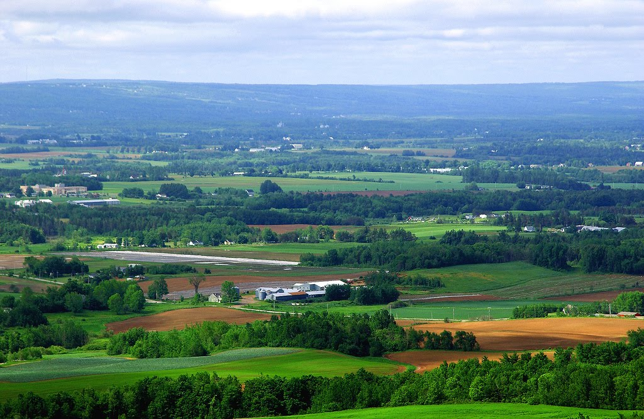

Slide 46
NS: Coverage
Routine biennial exams for under 10 & over 64. Clinically necessary exams for ocular disease, relevant systemic conditions and medications. Multiple partial visits for red eyes and amblyopia. Coverage for low vision, punctal plug insertion, naso lacrimal D&I

Slide 47
NS: Local Comments
“few openings in the HRM, will need to work multiple locations …. opportunities to potentially own practices in Cape Breton and Yarmouth”
“NS attracts ODs who are highly intelligent and extremely good looking (emphasis mine) ;-) and want to return home or those wishing a more rural, less fast paced/more balanced lifestyle.”
“Cost of living and taxation rates among the highest in Canada, population aging, wages may be lower than anticipated.”

Slide 48
New Brunswick

Slide 49
NB: Coverage
All optometric services were de-insured since 1992 except for children and adult family members on social income assistance

Slide 50
NB: Local Comments
“50% of population is rural so opportunities for solo full scope practice and there are several multi-doctor practices in the larger cities. Moncton/Dieppe & Fredericton are well supplied.”
“A few practices are looking for associates, several practitioners planning to retire in the next few years.”
“We boast camaraderie and cohesiveness – mentorship program for new members”
“Only officially bilingual province in the country, so being fully bilingual would be an asset.” C’est vrais, n’est pas?

Slide 51
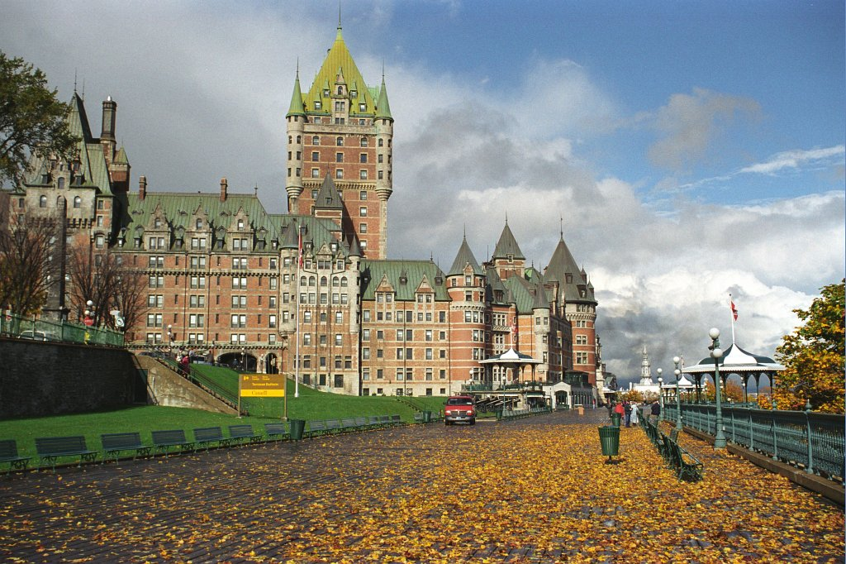
Quebec

Slide 52
QC: Coverage
Routine examinations for children and seniors. All patients covered for clinically necessary exams in presence of ocular disease, relevant systemic health issues & medications, ocular trauma or injury. Higher fee if patient 75 years of age or older.

Slide 53
QC: Local Comments
“Québec is the nicest place to live.”
“Reasonably good OD/OMD relationships”
“Fair fees, but not the highest in Canada.”
“Overall lowest population/OD ratio.”
“Mandatory fluency in French.”

Slide 54
Ontario

Slide 55
ON: Coverage
Periodic exams for all persons under 20 and over 64 and persons 20-64 with certain allowable medical conditions or upon physician (or RN) referral. Coverage if on social assistance. Some partial exams and VFA covered.

Slide 56
ON: Local Comments
The number of optometrists is currently growing faster than population needs.
Associate compensation is showing a downward trend.
Many new graduates work in multiple locations, especially in urban areas.
Government funded eye examinations are among the lowest in Canada.
Scope of practice is among the broadest in Canada

Slide 57
ON: Local Comments - Challenges
Low remuneration for insured services
Entrance of managed care
Increasing presence of unregulated eyewear dispensers
Ministry pilot projects on a diabetic eye disease screening model that does not involve optometrists
Increasing competition from corporate entities, unregulated dispensers, and opticians for eye wear dispensing.
Outdated regulations that govern business practices

Slide 58
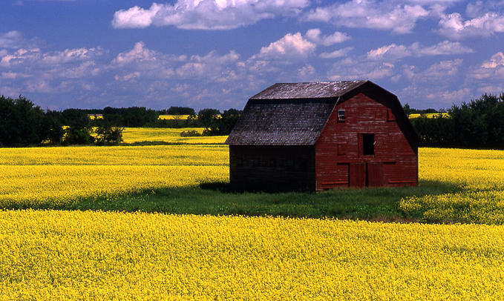
Manitoba

Slide 59
MB: Coverage
Routine biennial exams under 19 and over 64. All patients covered for clinically necessary exams in presence of ocular disease, relevant systemic health issues & medications, ocular trauma or injury.

Slide 60
MB: Local Comments
“Favourable real estate costs, stable economy, third lowest unemployment rate in country”
“Initial employment may be a patchwork of offices - one or two days a week in up to four or five offices. Within a year, most new registrants are working in only one or two offices. Some full-time opportunities in rural areas.”
“FINALLY! TPA legislation for ODs in 2013 – opticians are pushing hard for refraction.”

Slide 61
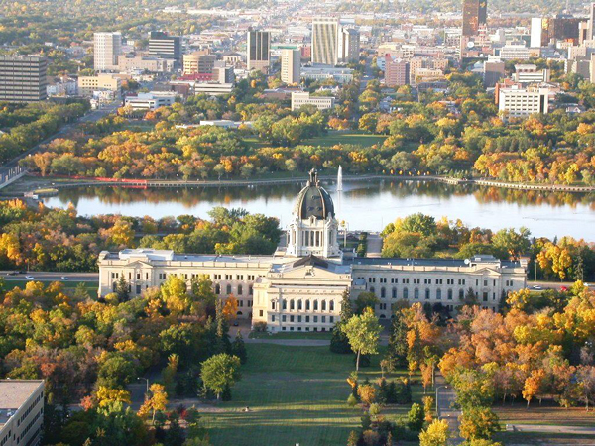
Saskatchewan

Slide 62
SK: Coverage
Routine annual exams under 18, low income seniors and persons on Family Health Benefit. All patients covered for clinically necessary exams in presence of ocular disease, relevant systemic health issues & medications, ocular trauma or injury. Routine examinations for patients with diabetes not covered.

Slide 63
SK: Local Comments
“Thriving and growing economy - cost of living and unemployment rates in Saskatchewan remain low in comparison to other provinces.”
“Market is becoming more competitive -28% increase in the number of ODs in the past 10 years, but new grads that are self-reliant and take charge of their time and life will be most successful. (Not 9-5 hours)
“Friendly people, wide open skies, beautiful sunsets, plentiful year round recreation and sports activities, many lakes, great place to raise a family”
Home of the 2013 Grey Cup Champions and the best fans in the country!

Slide 64
Alberta

Slide 65
AB: Coverage
Routine yearly exams under 19 & over 64. All patients covered for clinically necessary exams in presence of ocular disease, relevant systemic health issues & medications, ocular trauma or injury. Foreign body removal

Slide 66
AB: Local Comments
“85% of ODs in urban centres. Low demand for new optometrists in urban settings - best opportunities exist in rural areas. Good mentorship program for new grads”
“Expect economy to grow moderately for next 30 years (oil sands)”
“Opticians and optometrists looking to expand their scope of practice.”
“Online sales of eye wear and aggressive marketing by opticians.”
“Two NHL teams to cheer for. Maple Leaf fans need not come” (Alberta already has lots of dinosaurs)

Slide 67
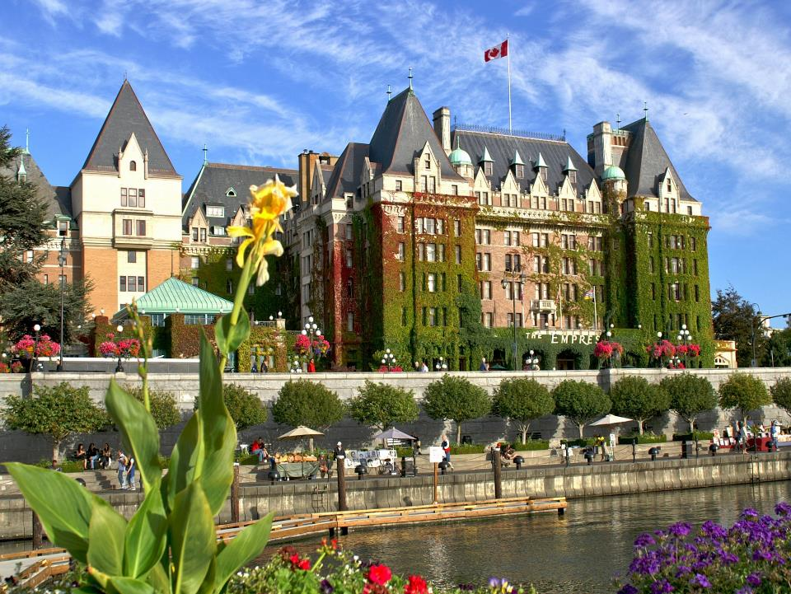
British Columbia

Slide 68
BC: Coverage
Routine annual exams under 19 & over 64. All patients covered for clinically necessary exams in presence of ocular disease (including glaucoma), relevant systemic health issues & medications, ocular trauma or injury.
The only province that permits “balance billing” in addition to fees covered by provincial health plan

Slide 69
BC: Local Comments
“influx of new ODs especially in urban centers - may mean working in more than one location… rural BC provides full scope practice opportunities and a good place to start
Competition from opticians doing independent sight tests, Clearly Contacts (on-line and bricks and mortar locations), influx of chains (Hakim, Optiks International)
Public education program “Healthy Eyes, Doctor Delivered” (adopted by CAO nationwide) to help differentiate optometrists and their services from those competing on price alone. Despite the challenges, optometrists are doing well
New grads need to get involved with their provincial association to promote optometry to the public and make a difference. Its your future!
Accepts NBEO as equivalent to CACO – only province to do so

Slide 70
Thank You
Dr. Henry Smit
smitnsao@ns.sympatico.ca

Slide 71
Questions?

Slide 72
Contacts
Canadian Association of Optometrists: opto.ca
Canadian Examiners in Optometry: ceo-eco.org
CAO’s National Public Education Committee: doctorsofoptometry.ca

